Slide 1
Applied Time Series YouTube Special
Professor Gerhard Kling
(YUNIKARN)

Slide 2
Background
https://uk.linkedin.com/in/gerhard-kling
https://twitter.com/GerhardklingS
About the course:
Academic version: Advanced Quantitative Research Methods (SOAS University of London): 2015-2019
Applied version: HMRC: 2012-2015
This version is a very applied and hands-on experience in data science – modified for YouTube
If you are new to Stata, have a look at my Data Science using Stata course
Feedback
DMs open on Twitter
Leave a comment – as YouTubers say: «hit the like button and subscribe!» ☺
Dr Gerhard Kling
1

Slide 3
Overview
Unit 0: Mathematical toolkit
Unit 1: Time series analysis and forecasting
Unit 2: ARIMA and seasonality
Unit 3: Intervention analysis
Unit 4: Vector autoregression (VAR)
Unit 5: Cointegration and VECM
Unit 6: Modelling conditional volatility
Unit 7: Structural breaks
Unit 8: Panel VAR and cointegration
Professor Gerhard Kling
1

Slide 4
Learning objectives
On successful completion of this module, participants will be able to:
demonstrate understanding of the basic theory of econometrics / statistics
demonstrate understanding of some specific applications of such theory
demonstrate competence in using an econometrics software package (STATA)
demonstrate quantitative skills in evaluating numerical data
apply statistical and econometric tools to problems
Problem-based learning in workshops
Analysing data
Using STATA
Organising your work using do-files
Interpretation of output
Professor Gerhard Kling
2

Slide 5
Unit 1: Time series analysis and forecasting
Professor Gerhard Kling

Slide 6
What is a time series?
A time series which refers to a sequence of realisations {y_{t}}
Hence, we observe one (or more) variables over time
When we focus on one time series and associated analyses, we use the term univariate time series analysis
When we analyse several time series (e.g. their interaction over time), we use the term multivariate time series analysis
This module mainly focuses on univariate time series modelling with the exception of cointegration
The main aim in time series modelling is forecasting (e.g. forecasting demand)
Professor Gerhard Kling
3

Slide 7
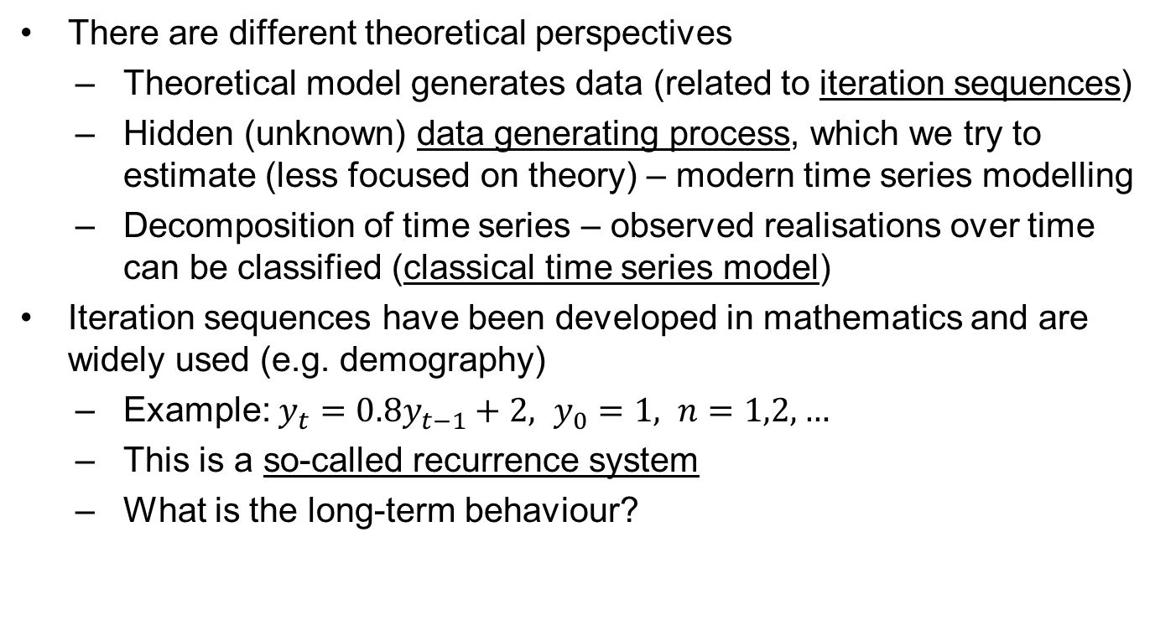
Who generates the data?
There are different theoretical perspectives
Theoretical model generates data (related to iteration sequences)
Hidden (unknown) data generating process, which we try to estimate (less focused on theory) – modern time series modelling
Decomposition of time series – observed realisations over time can be classified (classical time series model)
Iteration sequences have been developed in mathematics and are widely used (e.g. demography)
Example: $y_{t}={0.8y}_{t−1}+2, y_{0}=1, n=1,2,…$
This is a so-called recurrence system
What is the long-term behaviour?
Professor Gerhard Kling
4

Slide 8

Long-term behaviour
Two different start values: 20 and 80; fast convergence to 10
$$y_{2}=0.8y_{1}+2$$
$$y_{2}=0.8\left(0.8y_{0}+2\right)+2…$$
$$y_{n}={0.8}^{n}y_{0}+\sum_{n=0}^{n−1}{{0.8}^{n}×2}→10 as n→∞$$
Geometric series: $\frac{2}{1−0.8}=10$
Professor Gerhard Kling
5

Slide 9
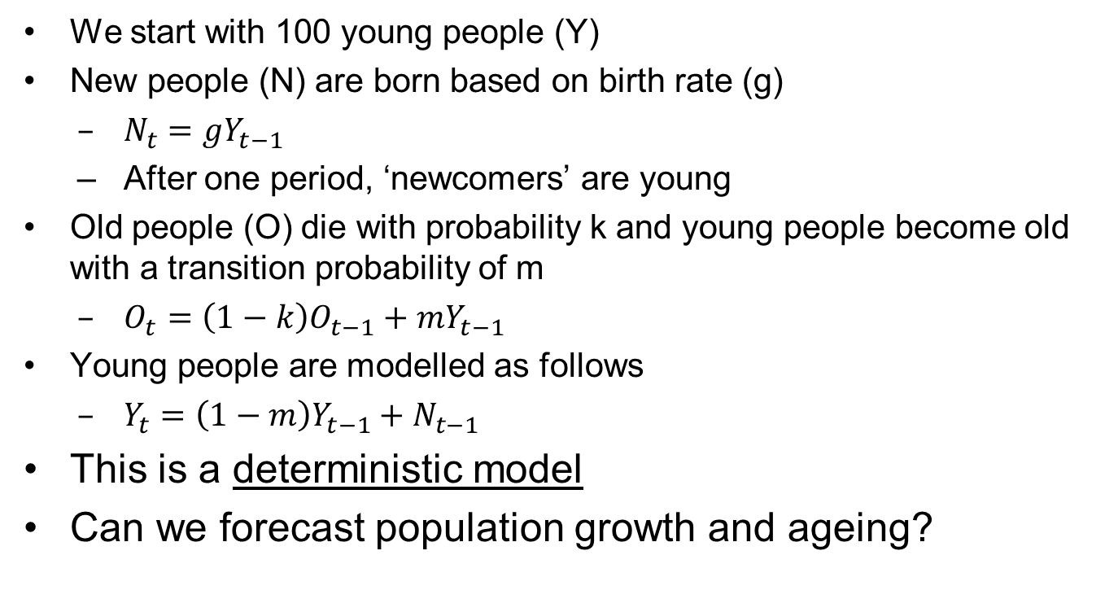
Example: demographic model
We start with 100 young people (Y)
New people (N) are born based on birth rate (g)
$N_{t}=gY_{t−1}$
After one period, ‘newcomers’ are young
Old people (O) die with probability k and young people become old with a transition probability of m
$O_{t}=\left(1−k\right)O_{t−1}+mY_{t−1}$
Young people are modelled as follows
$Y_{t}=\left(1−m\right)Y_{t−1}+N_{t−1}$
This is a deterministic model
Can we forecast population growth and ageing?
Professor Gerhard Kling
6

Slide 10
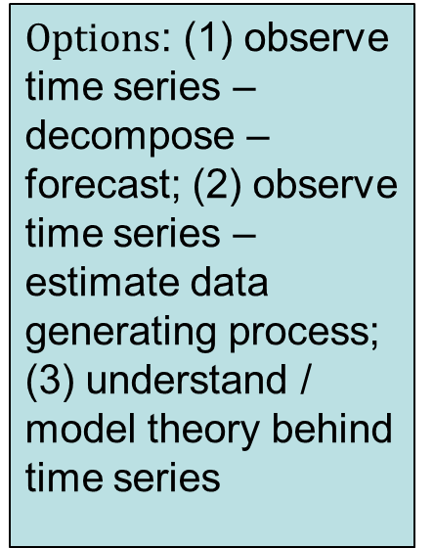
Forecast
What happens if we add noise?
$Options$: (1) observe time series – decompose – forecast; (2) observe time series – estimate data generating process; (3) understand / model theory behind time series
Professor Gerhard Kling
7

Slide 11
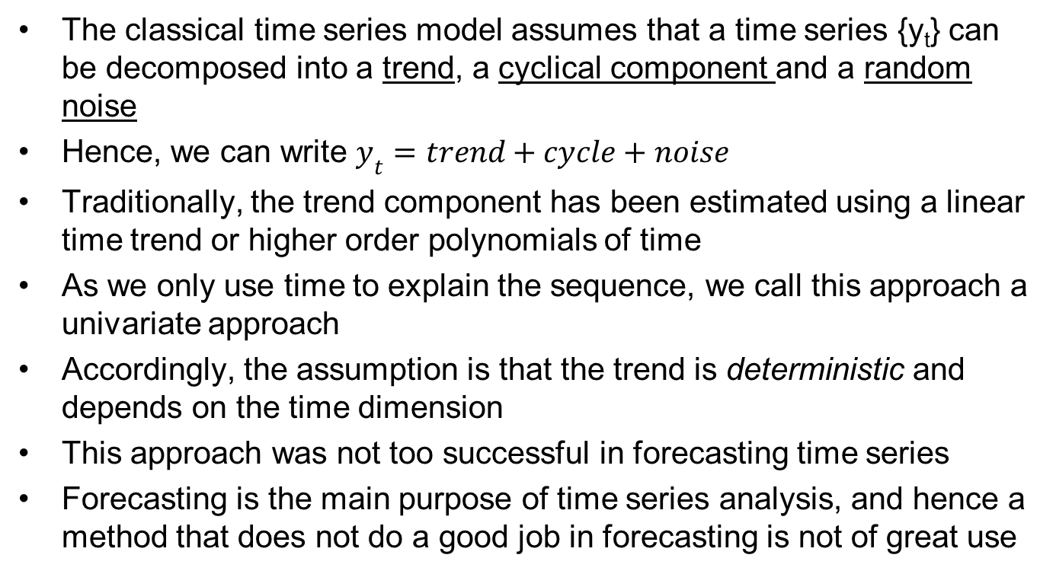
Classical time series model
The classical time series model assumes that a time series {y_{t}} can be decomposed into a trend, a cyclical component and a random noise
Hence, we can write $y_{t}=trend+cycle+noise$
Traditionally, the trend component has been estimated using a linear time trend or higher order polynomials of time
As we only use time to explain the sequence, we call this approach a univariate approach
Accordingly, the assumption is that the trend is deterministic and depends on the time dimension
This approach was not too successful in forecasting time series
Forecasting is the main purpose of time series analysis, and hence a method that does not do a good job in forecasting is not of great use
Professor Gerhard Kling
8

Slide 12
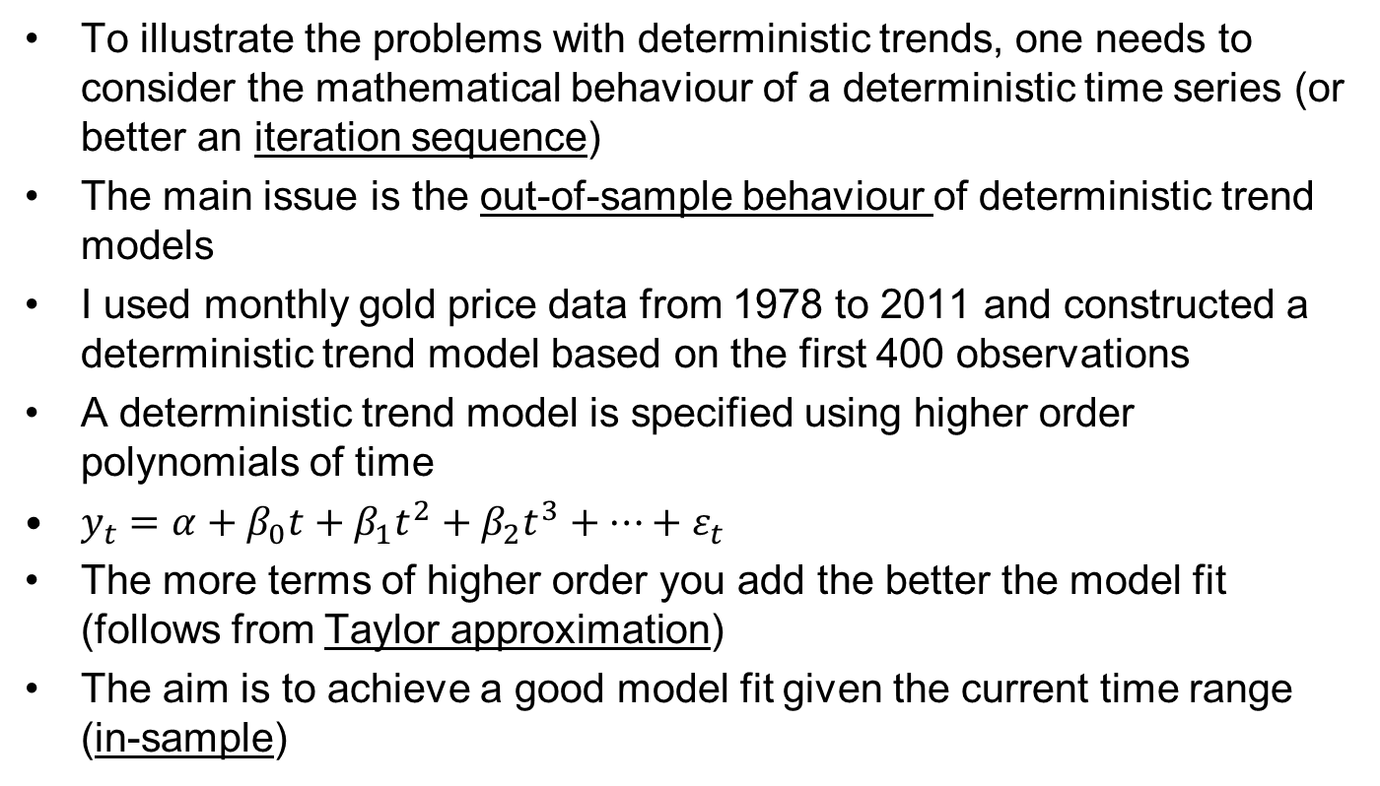
Deterministic trends
To illustrate the problems with deterministic trends, one needs to consider the mathematical behaviour of a deterministic time series (or better an iteration sequence)
The main issue is the out-of-sample behaviour of deterministic trend models
I used monthly gold price data from 1978 to 2011 and constructed a deterministic trend model based on the first 400 observations
A deterministic trend model is specified using higher order polynomials of time
$y_{t}=α+β_{0}t+β_{1}t^{2}+β_{2}t^{3}+…+ε_{t}$
The more terms of higher order you add the better the model fit (follows from Taylor approximation)
The aim is to achieve a good model fit given the current time range (in-sample)
Professor Gerhard Kling
9

Slide 13
In-sample model fit
The figure shows that the model looks very reasonable in-sample and achieved an R-squared of 99.9%
Start with linear model
Add higher orders following Ramsey RESET test (STATA: ‘ovtest’)
Until Ramsey RESET test cannot reject null hypothesis
Professor Gerhard Kling
10

Slide 14
Out-of-sample model fit
I then tried to forecast the next 10 years
The problem is the long-term behaviour of the deterministic iteration sequence (it tends to +/- infinity)
Use if command in STATA to restrict sample for regression models
Professor Gerhard Kling
11

Slide 15
Stationarity
The concept of stationarity contends that a time series is said to be stationary if and only if it has a constant mean, variance and covariance structure
Put differently, the realisations of the sequence {y_{t}} are drawn from the same random variable
In time series econometrics we call this a data generating process
For instance, if we observe 20 realisations we are able to estimate the moments (mean and variance) and the covariance structure (relationship between realisations over time) is constant
Stationarity is a prerequisite for many analyses, as a non-stationary time series does not have defined moments
Without defined moments, many analyses are useless
Professor Gerhard Kling
12

Slide 16
Stationarity and deterministic trends
If a time series has a deterministic trend (e.g. models in demography) then the time series is not stationary, as the trend implies that the time series increases or decreases over time
However, a time series can be de-trended
First, you need to identify the underlying deterministic behaviour
Second, you estimate the deterministic trend
Third, you determine the deviation of observed realisations from the fitted trend line
This process is called de-trended
Professor Gerhard Kling
13

Slide 17
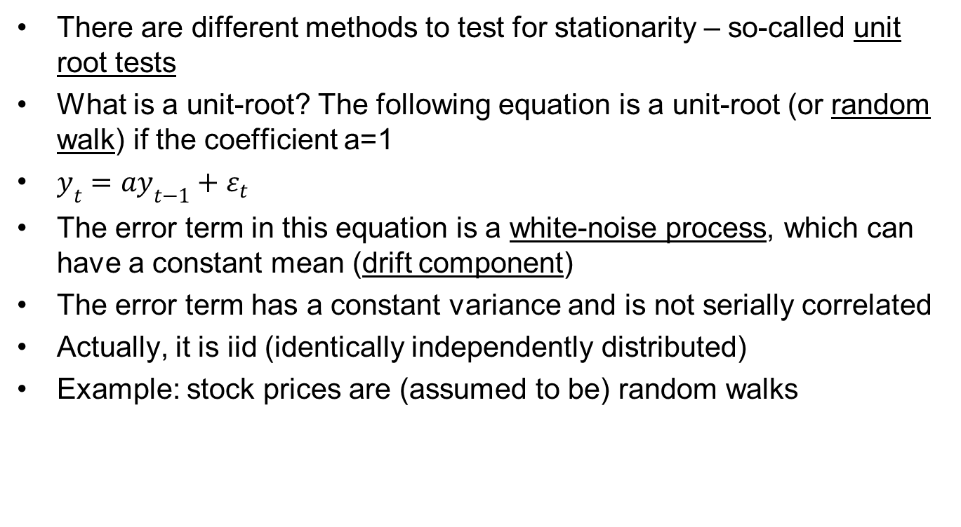
Unit roots
There are different methods to test for stationarity – so-called unit root tests
What is a unit-root? The following equation is a unit-root (or random walk) if the coefficient a=1
$y_{t}=ay_{t−1}+ε_{t}$
The error term in this equation is a white-noise process, which can have a constant mean (drift component)
The error term has a constant variance and is not serially correlated
Actually, it is iid (identically independently distributed)
Example: stock prices are (assumed to be) random walks
Professor Gerhard Kling
14

Slide 18
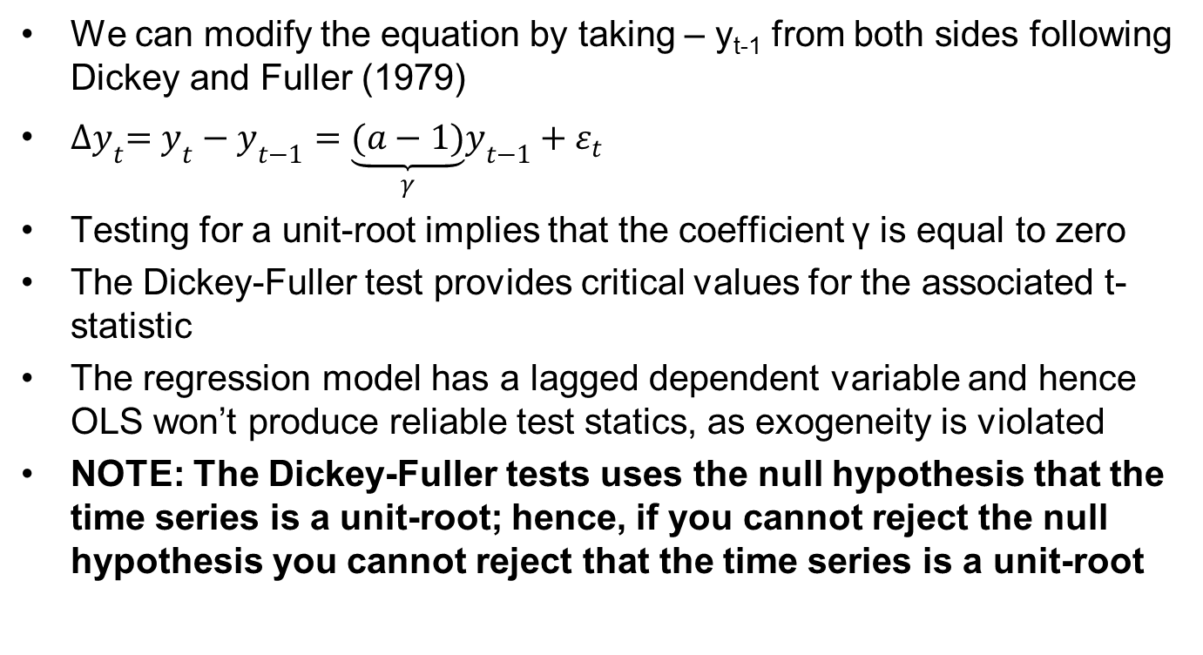
Dickey and Fuller test
We can modify the equation by taking – y_{t-1} from both sides following Dickey and Fuller (1979)
${∆y}_{t}=y_{t}−y_{t−1}=\underset{γ}{\underbrace{(a−1)}}y_{t−1}+ε_{t}$
Testing for a unit-root implies that the coefficient γ is equal to zero
The Dickey-Fuller test provides critical values for the associated t-statistic
The regression model has a lagged dependent variable and hence OLS won’t produce reliable test statics, as exogeneity is violated
NOTE: The Dickey-Fuller tests uses the null hypothesis that the time series is a unit-root; hence, if you cannot reject the null hypothesis you cannot reject that the time series is a unit-root
Professor Gerhard Kling
15

Slide 19
Stochastic trends
In STATA you need to ‘tsset’ your data first
As we work with only one dimension (time), you need to ‘tsset’ using a time variable (e.g. date, count)
Total population does not have a unit-root based on the Dickey-Fuller test indicated by a p-value of 0.000
What should we if we have a unit-root? This also means that we have a stochastic trend
How do we proceed if the time series has a unit-root?
First of all, a deterministic model cannot be applied, as the time series is non-stationary
One possibility is to first-difference the time series; hence, we deduct the lagged dependent variable to create a time series in first-differences that reflect the change in levels
Professor Gerhard Kling
16

Slide 20

Prices exhibit a unit-root
Example: Let’s take the first-difference of the gold price, and re-run the Dickey-Fuller test based on the first-difference
$y_{t}=y_{t−1}+ε_{t}⟹{∆y}_{t}=ε_{t}$
By inspection, the time series looks stationary
Like a white-noise process
However, the variance seems to change over time
Professor Gerhard Kling
17

Slide 21
Integrated time series
The first-differenced time series looks stationary in the sense that the time series seems to have a constant mean
However, the variance seems to change over time
Nevertheless, the variance seems to be bounded (so it does not approach infinity)
The Dickey-Fuller test has a p-value of 0.000; thus, we can reject the null hypothesis that the first-differenced time series has a unit-root
As the time series in levels has a unit-root and the first-differenced time series does not exhibit a unit root, we call this time series integrated of order one I(1)
We can now analyse the first-differenced time series using ARIMA models
Professor Gerhard Kling
18

Slide 22
Unit 2: ARIMA and seasonality
Professor Gerhard Kling

Slide 23
Confirming stationarity
The idea is to fit a model to a stationary time series that reflects the inherent serial correlation
Before we can use ARIMA, we need to show that the time series is stationary – to be more precise covariance stationarity is required in the sense that the autocorrelation structure has to be constant
Hence, before you start fitting ARIMA models you need to do the following
Test the time series for unit-roots (in STATA ‘dfuller’)
If the time series does not have a unit-root, you can start using ARIMA models
If the time series exhibits a unit-root, first-difference (or de-trend) the time series and apply Dickey-Fuller to the modified time series
You might need higher orders of differencing (e.g. I(2) series)
Professor Gerhard Kling
19

Slide 24
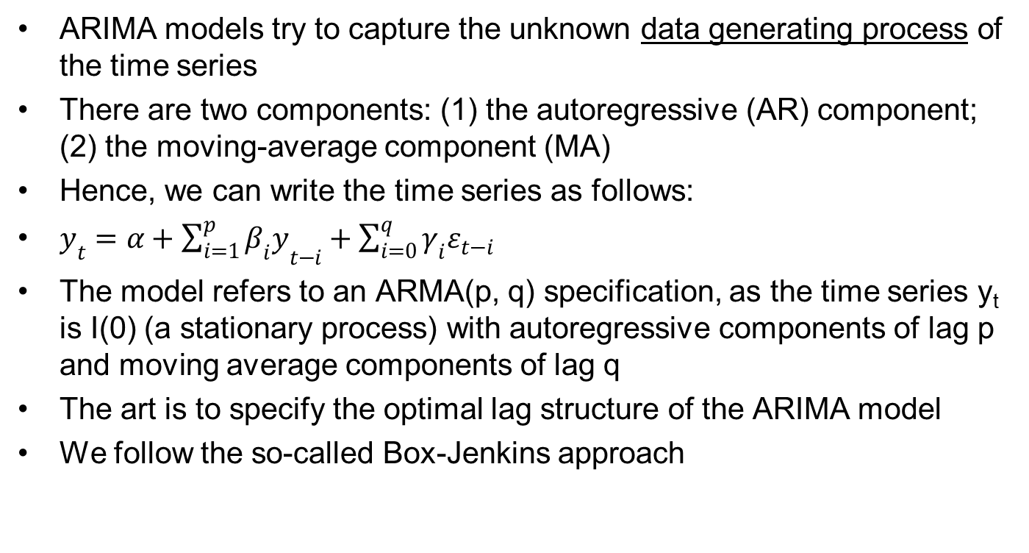
ARIMA
ARIMA models try to capture the unknown data generating process of the time series
There are two components: (1) the autoregressive (AR) component; (2) the moving-average component (MA)
Hence, we can write the time series as follows:
$y_{t}=α+{\sum_{i=1}^{p}{β_{i}y}}_{t−i}+\sum_{i=0}^{q}{γ_{i}ε_{t−i}}$
The model refers to an ARMA(p, q) specification, as the time series y_{t} is I(0) (a stationary process) with autoregressive components of lag p and moving average components of lag q
The art is to specify the optimal lag structure of the ARIMA model
We follow the so-called Box-Jenkins approach
Professor Gerhard Kling
20

Slide 25
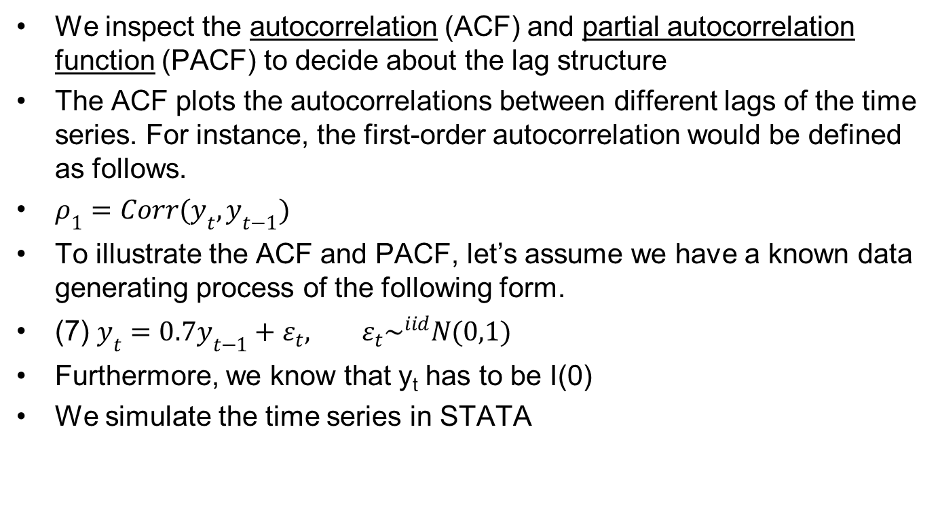
Box-Jenkins approach
We inspect the autocorrelation (ACF) and partial autocorrelation function (PACF) to decide about the lag structure
The ACF plots the autocorrelations between different lags of the time series. For instance, the first-order autocorrelation would be defined as follows.
$ρ_{1}=Corr(y_{t},y_{t−1})$
To illustrate the ACF and PACF, let’s assume we have a known data generating process of the following form.
(7) $y_{t}=0.7y_{t−1}+ε_{t}, ε_{t}\sim ^{iid}N(0,1)$
Furthermore, we know that y_{t} has to be I(0)
We simulate the time series in STATA
Professor Gerhard Kling
21

Slide 26
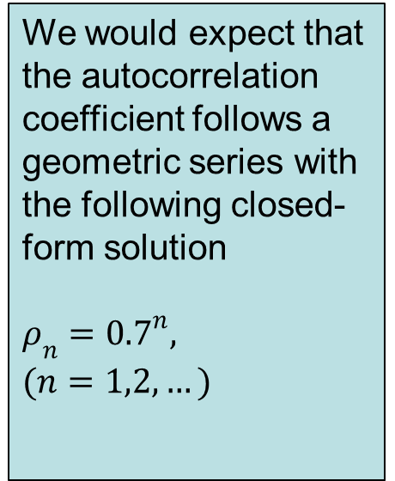
The ACF for an AR(1) process
The figure shows the ACF, which starts at around 0.7 and decays thereafter
We would expect that the autocorrelation coefficient follows a geometric series with the following closed-form solution
$$ρ_{n}={0.7}^{n},$$
$$(n=1,2,…)$$
Professor Gerhard Kling
22

Slide 27
The PACF for an AR(1) process
The PACF shows only a spike at lag one, which corresponds to the ACF. Thereafter partial autocorrelation becomes insignificant
Professor Gerhard Kling
23

Slide 28
Using ACF and PACF
A significant lag of the PACF suggests an AR(p) structure
A significant lag of the ACF suggests an MA(q) structure
One should stress that ACF and PACF can only be a starting point for a good ARIMA specification, as higher lag orders get quite complex to understand
Once you establish an ARIMA model, you should try different specifications and compare them using information criteria (Akaike AIC and Bayesian Schwarz BIC)
The BIC usually prefers a simpler model in terms of lag specifications
Try to find a simple model that maximises information criteria
After finding a simple ARIMA structure, you should explore the out-of-sample properties to assess parameter stability and the quality of forecasts
Professor Gerhard Kling
24

Slide 29
The ACF hard/softwood exports
First we test whether export of wood are stationary
The ACF shows a significant lag two and three
Professor Gerhard Kling
25

Slide 30
The PACF for wood exports
The PACF has significant lags up to lag three. I would ignore higher lags, as lag four is not significant
Professor Gerhard Kling
26

Slide 31
ARIMA for wood exports
Following the principle from general to specific, one could start with a slightly complex ARIMA(3, 1, 3)
Hence, we try AR(3) and MA(3) for the time series, which is I(1)
We run several specifications using Maximum Likelihood and compare AIC and BIC
ACF and PACF in STATA
For ACF use ‘ac’
For PACF use ‘pac’
ARIMA in STATA
Use ‘arima’ and specify the lags of the AR and MA component in options as ‘ar(p)’ and ‘ma(q)’
Professor Gerhard Kling
27

Slide 32
Comparing ARIMA models
The following table shows different model specifications
Model C seems to be superior in terms of AIC and BIC
Professor Gerhard Kling
28

Slide 33
Have we found a ‘best’ model?
The ARIMA(3,1,3) concern me a bit, as the coefficients increase with the lag. That could point to instability problems
Once the MA components are removed the AR coefficients are significant
Good quality of forecasts
Professor Gerhard Kling
29

Slide 34
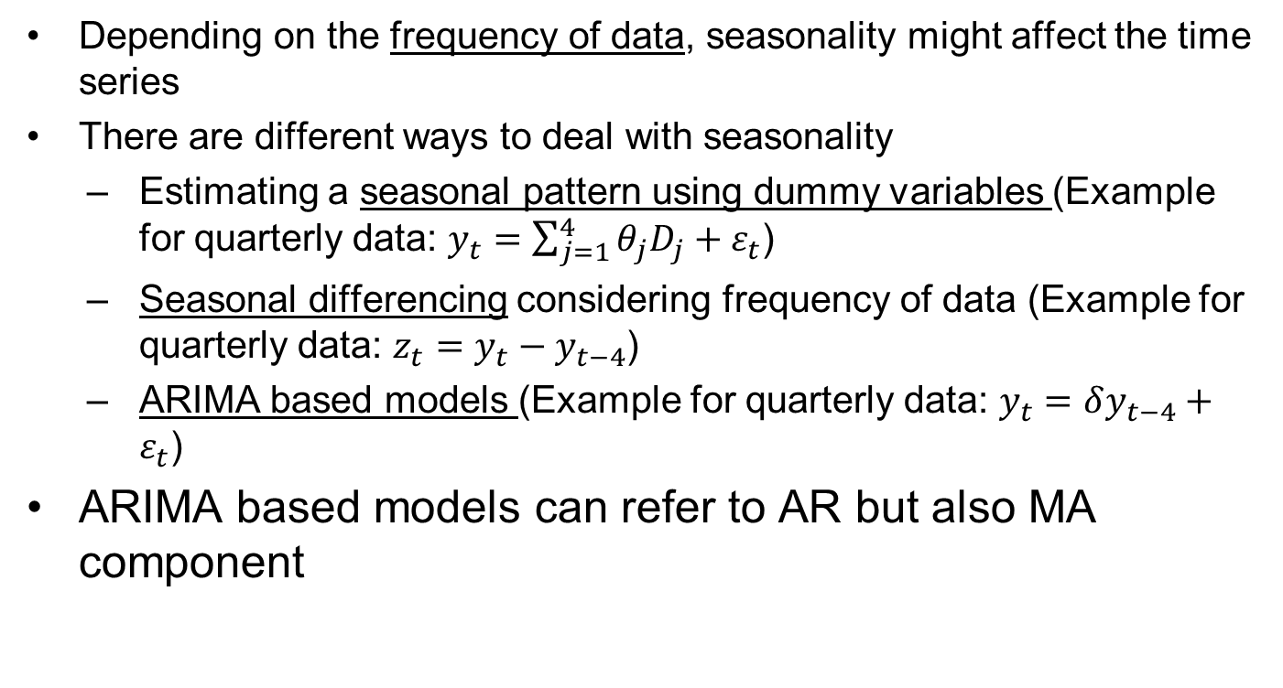
Seasonality
Depending on the frequency of data, seasonality might affect the time series
There are different ways to deal with seasonality
Estimating a seasonal pattern using dummy variables (Example for quarterly data: $y_{t}=\sum_{j=1}^{4}{θ_{j}D_{j}}+ε_{t}$)
Seasonal differencing considering frequency of data (Example for quarterly data: $z_{t}=y_{t}−y_{t−4}$)
ARIMA based models (Example for quarterly data: $y_{t}=δy_{t−4}+ε_{t}$)
ARIMA based models can refer to AR but also MA component
Professor Gerhard Kling
30

Slide 35
Workshop 1: Analysing credit card loans in the UK
Professor Gerhard Kling

Slide 36
To-do list (1/2)
Open the dataset ‘Workshop 1’
Define a time dimension and ‘tsset’ your data so that STATA knows that you work with a time series
Plot a line chart for ‘net_loan’ (net credit card loans, outstanding balance, monthly data
Test whether the time series is stationary
Determine the order of integration of the time series
Determine the monthly growth rate of net credit card loans (label ‘m_growth’)
Explore the behaviour of ‘m_growth’ over time
Does ‘m_growth’ exhibit a seasonal pattern?
Are there any other issues?
Professor Gerhard Kling
31

Slide 37
To-do list (2/2)
Try to estimate a seasonal pattern using dummies for the 12 months
HINT: think about fast ways to create the 12 dummies for each month; you also need to convert the string variable ‘date’ into something more useful (explore the ‘date’ command)
Predict the seasonal pattern and seasonally adjust the time series
Fit an ARIMA specification and select the best model
Consider dummies (structural break) for extreme outliers
Try out-of-sample forecasts for the last 12 months
Consider adding the seasonal pattern to your forecast
Determine the mean-square error (MSE) for the forecast with and without seasonal pattern
Professor Gerhard Kling
32

Slide 38
Unit 3: Intervention analysis
Professor Gerhard Kling

Slide 39
Intervention analysis
The aim of an intervention analysis is to quantify the impact of a policy change (e.g. intervention) on a time series
There are a few challenges we need to address
Policy changes are sometimes anticipated (e.g. introduction of the Euro, increase in VAT) – how can we model anticipation?
Policy changes might have a short and / or long-term effect
Policy changes might take some time to influence a time series – this is called a lag
We need to isolate the ‘normal behaviour’ of a time series
We use ARIMA models to capture the normal behaviour and include dummy variables for the policy change into the mean-equation
Professor Gerhard Kling
33

Slide 40
The type of intervention
Some policy changes (or events) only affect a certain time period (e.g. tax cuts that expire after one year, stamp duty exemptions)
Other policy changes are long lasting (e.g. joining the WTO)
Dummy variables can be modified to capture certain time periods to mimic the desired effect
Dummy takes the value 1 if time is equal to the immediate policy change (e.g. announcement effect) and 0 otherwise
Dummy takes the value 1 for a certain time period and 0 otherwise
Example: China joined the WTO in 2001; dummy takes the value 1 for year ≥ 2001 and 0 otherwise
Professor Gerhard Kling
34

Slide 41
First step: ARIMA model
We need to capture the normal behaviour of the time series
Hence, we use univariate methods to model the time series, namely ARIMA models
We follow the standard Box-Jenkins Approach
Explore ACF
Explore PACF
Use general-to-specific approach and find the best model
Check the model specification using information criteria (minimise AIC and BIC; if AIC and BIC disagree, go for BIC)
It is common to use the whole time period (before and after the policy change) to specify an ARIMA model
Professor Gerhard Kling
35

Slide 42
FDI inflows into the UK
The following time series shows FDI (foreign direct investment) inflows into the UK
We see a pronounced decline in 2001 (dot- com bubble) and 2008 (current financial crisis)
We try to quantify the impact of the financial crisis 2008
Professor Gerhard Kling
36

Slide 43
ARIMA for FDI inflows
We follow the standard procedure as outlined in STATA
*Dickey-Fuller test
dfuller uk_fdi
dfuller d.uk_fdi
*Integrated of order 1
*ARIMA specification
ac d.uk_fdi
pac d.uk_fdi
arima d.uk_fdi, ar(1/3) ma(1/3)
estimates store A
arima d.uk_fdi, ar(1/3)
estimates store B
arima d.uk_fdi, ar(3)
estimates store C
predict y
estimates table A B C, b(%9.3f) star stat(aic bic N)
Professor Gerhard Kling
37

Slide 44
Let’s have a look at ARIMA
We fit an ARIMA model and try to predict the time series
The decline in 2001 and 2008 seems to be unexplained by our ARIMA specification
Professor Gerhard Kling
38

Slide 45
Second step: intervention
We need to determine the type of intervention (e.g. short or long-term effect)
In our example, the financial crisis has started in 2008 – but it does not seem to stop any time soon
I would try to use the following dummy to capture the (alleged) long-lasting effect
*Financial crisis dummy
gen crisis=1 if year>=2008
replace crisis=0 if crisis==.
*Explore cross-correlation
xcorr d.uk_fdi crisis, lags(4)
Professor Gerhard Kling
39

Slide 46
Third step: cross-correlation
To understand whether the policy change (or event) was anticipated or had a long-lasting effect, we explore the cross-correlation
Note that negative lags are leads (anticipation)
We see an immediate impact (at 0) and a lagged impact (at 1 and 2)
Professor Gerhard Kling
40

Slide 47
Fourth step: reconsider impact
Based on cross-correlation, we know the following
Event was not anticipated
Event had an immediate effect, which was negative
And the event had a long-lasting impact one and two years afterwards
We might consider using a different dummy specification, which only takes the value 1 in the year 2008
We also might include lagged dummies to capture the impact one or two years later
By doing that, we allow that the effect declines over time
Professor Gerhard Kling
41

Slide 48
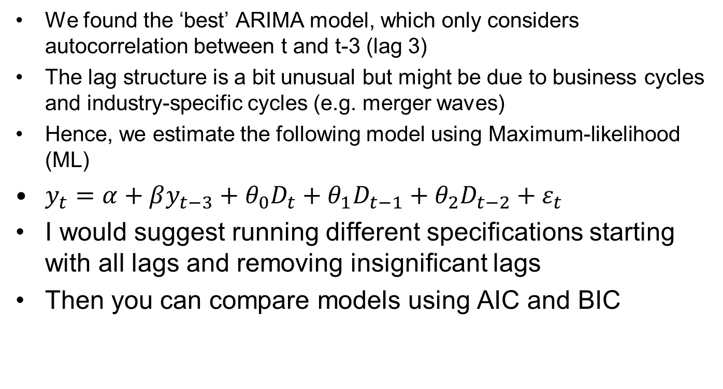
Fifth step: estimate model
We found the ‘best’ ARIMA model, which only considers autocorrelation between t and t-3 (lag 3)
The lag structure is a bit unusual but might be due to business cycles and industry-specific cycles (e.g. merger waves)
Hence, we estimate the following model using Maximum-likelihood (ML)
$y_{t}=α+βy_{t−3}+θ_{0}D_{t}+θ_{1}D_{t−1}+θ_{2}D_{t−2}+ε_{t}$
I would suggest running different specifications starting with all lags and removing insignificant lags
Then you can compare models using AIC and BIC
Professor Gerhard Kling
42

Slide 49
Models for FDI and the crisis
The table provides different model specifications
Based on AIC and BIC, model A (the general model) seems to be superior
Professor Gerhard Kling
43

Slide 50
Illustration of impact
We can derive so-called impulse response functions analytically
STATA does not provide impulse response functions for intervention models, but they can be calculated and programmed in STATA
And easier approach is to compare the predicted values based on the standard ARIMA model and the intervention model
The differences in predicted values are due to the intervention effect (however, ARIMA is also affected so it is not 100% accurate)
Effect ‘translated’ by the ARIMA structure into 2011 and later periods
Professor Gerhard Kling
44

Slide 51
Unit 4: Vector autoregression (VAR)
Professor Gerhard Kling

Slide 52
Vector autoregression (VAR)
The classical linear regression model assumes strict exogeneity; hence, there is no serial correlation between error terms and any realisation of any independent variable (lead or lag)
As we discovered, serial correlation (or autocorrelation) is very common in financial time series and panel data
Furthermore, we assumed a pre-defined relation of causality: explanatory variable affect the dependent variable
We now relax both assumptions using a VAR model. VAR models can be regarded as a generalisation of AR(p) processes by adding additional time series
Hence, we enter the field of multivariate time series analysis
Professor Gerhard Kling
45

Slide 53
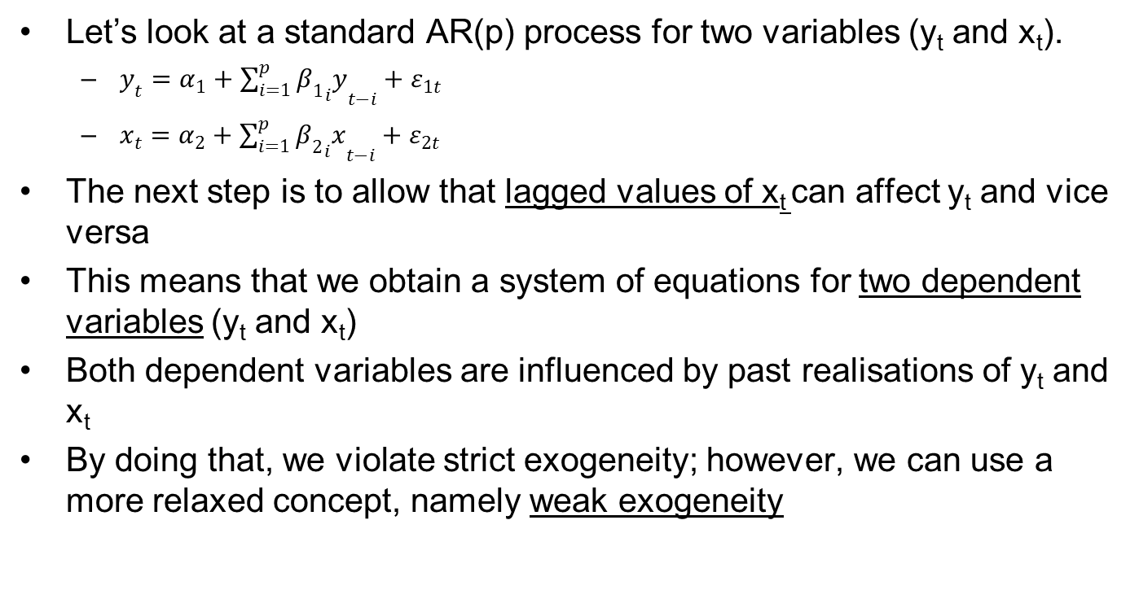
The VAR model (1/2)
Let’s look at a standard AR(p) process for two variables (y_{t} and x_{t}).
$y_{t}=α_{1}+{\sum_{i=1}^{p}{{β_{1}}_{i}y}}_{t−i}+ε_{1t}$
$x_{t}=α_{2}+{\sum_{i=1}^{p}{{β_{2}}_{i}x}}_{t−i}+ε_{2t}$
The next step is to allow that lagged values of x_{t} can affect y_{t} and vice versa
This means that we obtain a system of equations for two dependent variables (y_{t} and x_{t})
Both dependent variables are influenced by past realisations of y_{t} and x_{t}
By doing that, we violate strict exogeneity; however, we can use a more relaxed concept, namely weak exogeneity
Professor Gerhard Kling
46

Slide 54
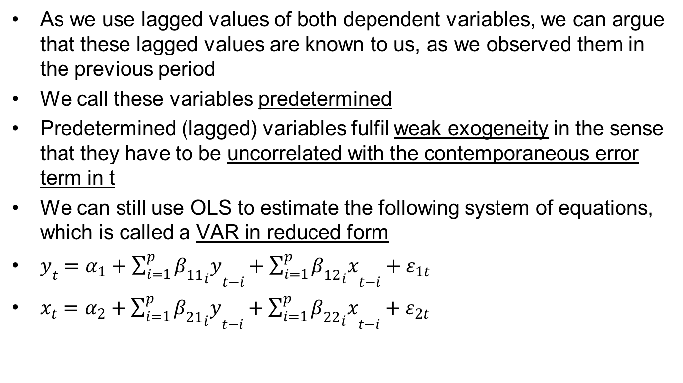
The VAR model (2/2)
As we use lagged values of both dependent variables, we can argue that these lagged values are known to us, as we observed them in the previous period
We call these variables predetermined
Predetermined (lagged) variables fulfil weak exogeneity in the sense that they have to be uncorrelated with the contemporaneous error term in t
We can still use OLS to estimate the following system of equations, which is called a VAR in reduced form
$y_{t}=α_{1}+{\sum_{i=1}^{p}{{β_{11}}_{i}y}}_{t−i}+{\sum_{i=1}^{p}{{β_{12}}_{i}x}}_{t−i}+ε_{1t}$
$x_{t}=α_{2}+{\sum_{i=1}^{p}{{β_{21}}_{i}y}}_{t−i}+{\sum_{i=1}^{p}{{β_{22}}_{i}x}}_{t−i}+ε_{2t}$
Professor Gerhard Kling
47

Slide 55
The benefits of VAR modelling
The beauty of this model is that we don’t need to predefine whether x or y are endogenous (the dependent variable)
In fact, we can test whether x (y) is endogenous or exogenous using Granger causality tests
The idea of Granger causality is that past observations (lagged dependent variables) can influence current observations – but not vice versa
So the idea is rather simple: the past affects the present, and the present does not affect the past
STATA provides Granger causality tests after conducting a VAR analysis, which is based on testing the joint hypothesis that past realisations do not Granger cause the present realisation of the dependent variable
Professor Gerhard Kling
48

Slide 56
Prerequisites for VAR modelling
Before you start using a VAR model, you have to make sure that the time series are stationary
So the first step is to check whether the time series is stationary using Dickey-Fuller tests (and/or KPSS tests)
The second step is to specify the optimal lag length (p) of the model
This is done by comparing different model specifications using information criteria
Apart from using Akaike (AIC) and Bayesian Schwarz (BIC), the Hannan-Quinn (HQIC) is commonly used
Most applied econometricians favour the Hannan-Quinn (HQIC) criterion
STATA will help you to make a good choice
After specifying your model, you need to check stability conditions
Professor Gerhard Kling
49

Slide 57
VAR for house prices - inflation
Let’s look at an example to see how VAR modelling works
In the previous Unit, we tried very hard to understand ARIMA and interaction effects
We extend our univariate model by exploring the relationships between house prices and inflation
From a theoretical perspective, house prices are regarded as an inflation hedge
Let’s have a closer look whether that is true
Before we do any sophisticated modelling, it is always beneficial to look at some line charts
Professor Gerhard Kling
50

Slide 58
House prices and inflation
The figure shows the indexed time series of house prices and the retail price index (RPI)
House prices bet inflation at least in the long run
Is there a link between the time series?
Professor Gerhard Kling
51

Slide 59
Checking model assumptions
Before we can use VAR, we need to ensure that both time series are stationary
It is obvious from the figure that both time series are not stationary
However, after taking a first-difference we can show that price changes are stationary
So both time series are I(1)
The next step is to determine the optimal lag length using information criteria
The following table shows different specifications
In STATA use the ‘varsoc’ command
Professor Gerhard Kling
52

Slide 60
The optimal lag length
We use ‘varsoc’ and obtain the following
Based on the AIC and HQIC, six lags are optimal; however, the (S)BIC prefers only four lag. I would prefer HQIC and try six lags first. If the additional lags do not exhibit significant coefficients, we could try to reduce the lag length in line with (S)BIC
Professor Gerhard Kling
53

Slide 61
Estimating a VAR in STATA
We run a VAR
We see that house prices are mainly driven by past house price changes – but not by inflation
Professor Gerhard Kling
54

Slide 62
Granger causality test
To test whether inflation Granger causes house prices or vice versa, we run Granger causality tests (in STATA use ‘vargranger’ after ‘var’)
Hence, we confirm that past changes in inflation cannot predict future house price changes.
Professor Gerhard Kling
55

Slide 63
Stability of the VAR
Finally, we need to show that the VAR is stable (in STATA ‘varstable’ after ‘var’)
This confirms stability
Professor Gerhard Kling
56

Slide 64
Dynamics
Finally, we can illustrate the impact of house price changes on future changes in inflation (or vice versa) using an impulse response function
The following figure shows the impulse response function and confidence intervals derived from bootstrapping
If house prices increase today by 1%, we should expect a significant increase in house prices in future
In STATA you need to do the following
Run a ‘var’ command fist with the variables x and y
irf create r
irf graph irf, impulse(x) response(y)
NOTE: check irf des to ensure that the right file was saved; if not use irf drop to delete old estimates
Professor Gerhard Kling
57

Slide 65
Impulse response function
Now we can illustrate the dynamics using impulse response functions
The grey area indicates the 95% confidence interval for the dynamic response
The steps indicate the time it takes to trigger the respective response
Professor Gerhard Kling
58

Slide 66
Structural VAR
Thus far, we analysed VAR in reduced form, which means that only past observations affect present observations
There is a possibility to allow that contemporaneous effects exist
For instance, house prices in t might react to inflation in t (maybe due to how both variables are measured)
Structural VARs (in STATA: ‘svar’) can model these interrelationships using a so-called Choleski decomposition
Inflation has an immediate effect on house prices, which is positive
So house prices react fact to inflation; thus, lagged inflation is already priced into current house prices
Professor Gerhard Kling
59

Slide 67
Structural impulse response
The impact is quite small, but significant
Professor Gerhard Kling
60

Slide 68
Workshop 2: Analysing house prices in the UK
Professor Gerhard Kling

Slide 69
To-do list (1/2)
Open the dataset ‘Workshop 2’
You find annual data on rents and quarterly data on house prices
The variable rent refers to an indexed value (so it does not reflect actual rents paid per year in GBP), and house prices are in GBP
Determine the annual growth rate in rents and the annual growth rate in house prices since 1988
HINT: think about different ways to do the first-differencing using quarterly data
HINT: you need to ensure that observations of annual growth in rents and house prices are matched (check the data structure in the data editor)
Think about ways to shift data
Professor Gerhard Kling
61

Slide 70
To-do list (2/2)
Check whether the time series of growth rates are stationary
Specify a VAR model
Select optimal lag length
Estimate VAR in reduced form
Check stability condition
Test for Granger causality
Illustrate the dynamics using
Impulse response functions
Forecasting variance decomposition (HINT: use STATA help function)
Professor Gerhard Kling
62

Slide 71
Unit 5: Cointegration and VECM
Professor Gerhard Kling

Slide 72
Common stochastic trend
We can see that silver and gold prices exhibit a certain degree of co-movement
We could almost argue that they share a common stochastic trend
The limitation of ARIMA and VAR models is that they can be only used if the time series are stationary
In our case, we had to first-difference your time series to ensure stationarity
First-differencing eliminates a lot of information in the time series.
Is there no better way to analyse gold and silver prices?
Professor Gerhard Kling
63

Slide 73
Co-movement of time series
Long before the development of multivariate time series econometrics, people realised that gold and silver seem to have a common movement around a long-term equilibrium (e.g. gold-silver price ratio)
Moreover, the idea of equilibrium conditions in economics and the availability of macroeconomic time series led to the development of cointegration analysis.
The idea is very simple. Even if two (or more) time series are non-stationary and hence have stochastic trends, they might be still driven by the same underlying factors that lead to their stochastic behaviour
Therefore, we analyse the time series in levels and see whether we can find a long-term equilibrium – a so-called cointegrating vector
Professor Gerhard Kling
64

Slide 74
Pair-trading
Pair-trading is a very common strategy used by investors
The idea is to benchmark two (or more) similar assets (e.g. Barclays and RBS)
Similar assets tend to exhibit a certain degree of co-movement, as they are influenced by similar factors (e.g. industry shocks, business cycles, factor prices)
We can estimate the long run relationship between assets and determine whether an asset is under or overvalued
Trading strategy: buy undervalued asset and sell overvalued asset
This also implies a hedge, as both assets are affected by similar shocks
Example: US steel makers
Professor Gerhard Kling
65

Slide 75
US steel makers
There is a certain degree of co-movement of US steel and Titan
Co-movements might break down due to structural changes
This needs to be considered (see discussion of structural breaks)
Professor Gerhard Kling
66

Slide 76
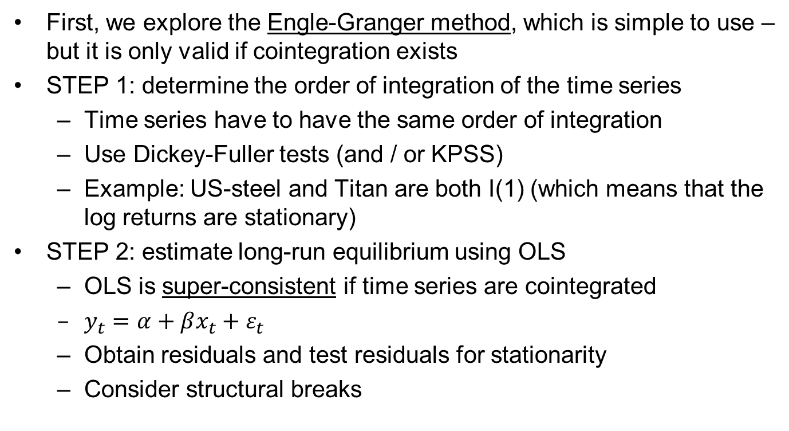
Test for cointegration (1/2)
First, we explore the Engle-Granger method, which is simple to use – but it is only valid if cointegration exists
STEP 1: determine the order of integration of the time series
Time series have to have the same order of integration
Use Dickey-Fuller tests (and / or KPSS)
Example: US-steel and Titan are both I(1) (which means that the log returns are stationary)
STEP 2: estimate long-run equilibrium using OLS
OLS is super-consistent if time series are cointegrated
$y_{t}=α+βx_{t}+ε_{t}$
Obtain residuals and test residuals for stationarity
Consider structural breaks
Professor Gerhard Kling
67

Slide 77
Long-run equilibrium
We estimate the long-run equilibrium using OLS
Professor Gerhard Kling
68

Slide 78
Explore residuals
Plot residuals over time
It looks like a structural break
Residuals are not stationary
Up to time=800, residuals are stationary and cointegration exists
Professor Gerhard Kling
69

Slide 79
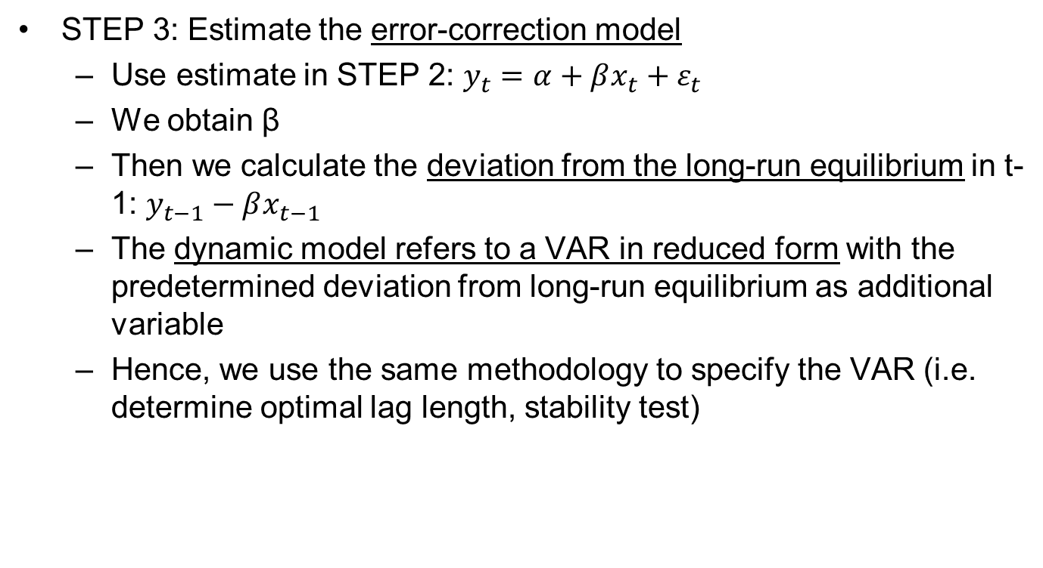
Test for cointegration (2/2)
STEP 3: Estimate the error-correction model
Use estimate in STEP 2: $y_{t}=α+βx_{t}+ε_{t}$
We obtain β
Then we calculate the deviation from the long-run equilibrium in t-1: $y_{t−1}−βx_{t−1}$
The dynamic model refers to a VAR in reduced form with the predetermined deviation from long-run equilibrium as additional variable
Hence, we use the same methodology to specify the VAR (i.e. determine optimal lag length, stability test)
Professor Gerhard Kling
70

Slide 80
The error-correction model
We follow the following steps in STATA
*STEP 3: error-correction model
reg us_steel titan if time<800
matrix b=get(_b)
matrix beta=b[1,1]
svmat beta, n(beta)
egen beta=max(beta1)
drop beta1
replace beta=. if time>=800
*Error-component in t-1
gen ec=l.us_steel-beta*l.titan
Professor Gerhard Kling
71

Slide 81
Optimal lag seems to be zero
Varsoc seems to favour lag zero
I would still try and run VAR models with lag 1 or 2 and check whether lags are significant
Professor Gerhard Kling
150

Slide 82
VECM with two lags
Some lags are significant!
Titan seems to adjust back into equilibrium
Professor Gerhard Kling
72

Slide 83
Forecast price movement
We can use the VECM to forecast confidence interval of price movements
This can be used to create buy and sell signals
Professor Gerhard Kling
73

Slide 84
Johansen procedure
Before we can use the Johansen procedure, we have to make sure that the time series have the same order of integration I(p)
We already know that both time series are I(1)
The following table shows the results of the Johansen test for cointegration
In line with the VAR model, we use two lags
The null hypothesis that there is no cointegration (r=0) can be rejected
However, the null hypothesis that we have one cointegrating vector (r=1) cannot be rejected
So the Johansen procedure also supports cointegration
Professor Gerhard Kling
74

Slide 85
Johansen procedure in STATA
In STATA use the ‘johans’ command, which needs to be downloaded from the STATA server (use help function)
Professor Gerhard Kling
75

Slide 86
Unit 6: Modelling conditional volatility
Professor Gerhard Kling

Slide 87
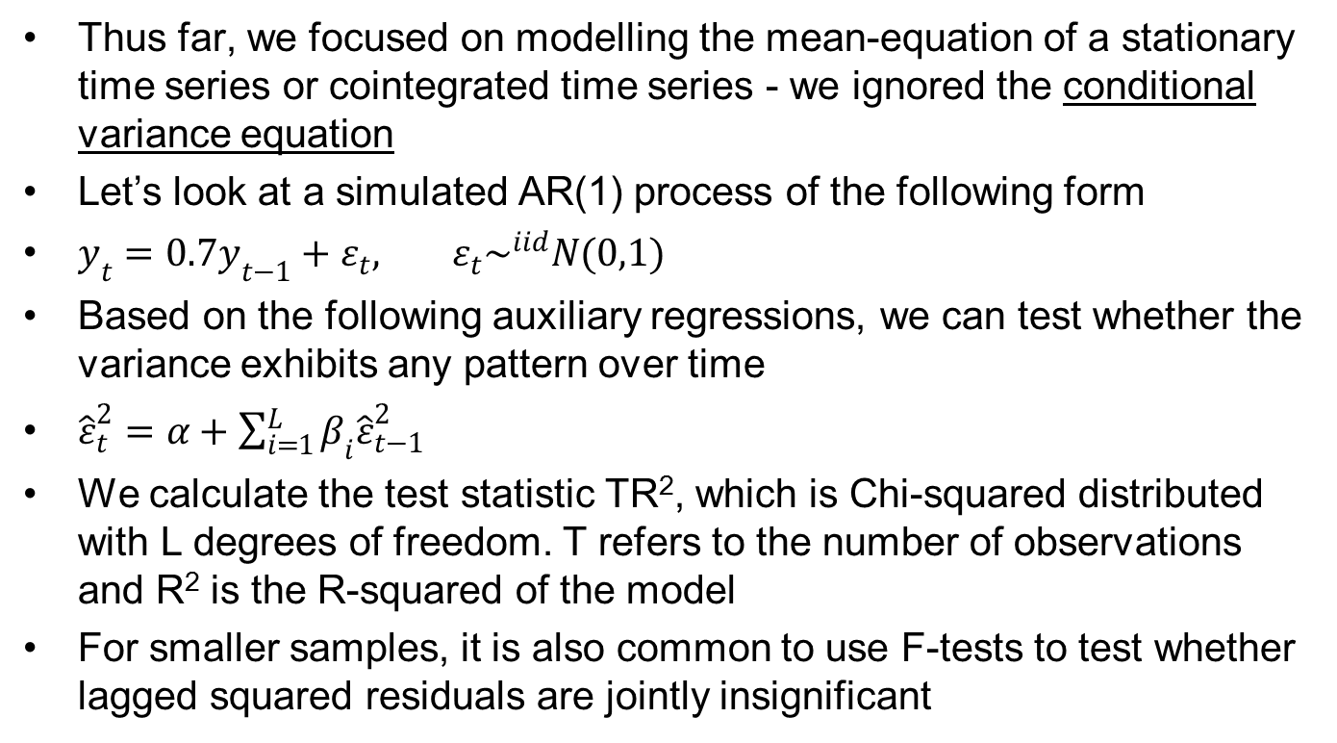
Modelling conditional means
Thus far, we focused on modelling the mean-equation of a stationary time series or cointegrated time series - we ignored the conditional variance equation
Let’s look at a simulated AR(1) process of the following form
$y_{t}=0.7y_{t−1}+ε_{t}, ε_{t}\sim ^{iid}N(0,1)$
Based on the following auxiliary regressions, we can test whether the variance exhibits any pattern over time
${\hat{ε}}_{t}^{2}=α+\sum_{i=1}^{L}{β_{i}{\hat{ε}}_{t−1}^{2}}$
We calculate the test statistic TR², which is Chi-squared distributed with L degrees of freedom. T refers to the number of observations and R² is the R-squared of the model
For smaller samples, it is also common to use F-tests to test whether lagged squared residuals are jointly insignificant
Professor Gerhard Kling
76

Slide 88
Conditional variance of AR(1)
There is no pattern
This is expected, as we simulated the AR(1) process, which only focuses on the mean-equation
Professor Gerhard Kling
77

Slide 89
Variance patterns
Real time series often exhibit patterns in their conditional variance
The models we discussed thus far ignored any change in variance
In fact, we assume that error terms are identically independently distributed with a constant variance and a mean of zero
Why does the variance change over time?
Looking at market data – higher variance reflects uncertainty
Why are we interested in modelling conditional variance?
Forecasting variance is beneficial (e.g. early warning system, insurance against market fluctuations, impact on option pricing)
Professor Gerhard Kling
78

Slide 90
Stock returns in China
The figure shows daily stock returns of the stock market index in Shanghai
There are clusters of higher volatility
The conditional variance is not constant over time
Professor Gerhard Kling
79

Slide 91
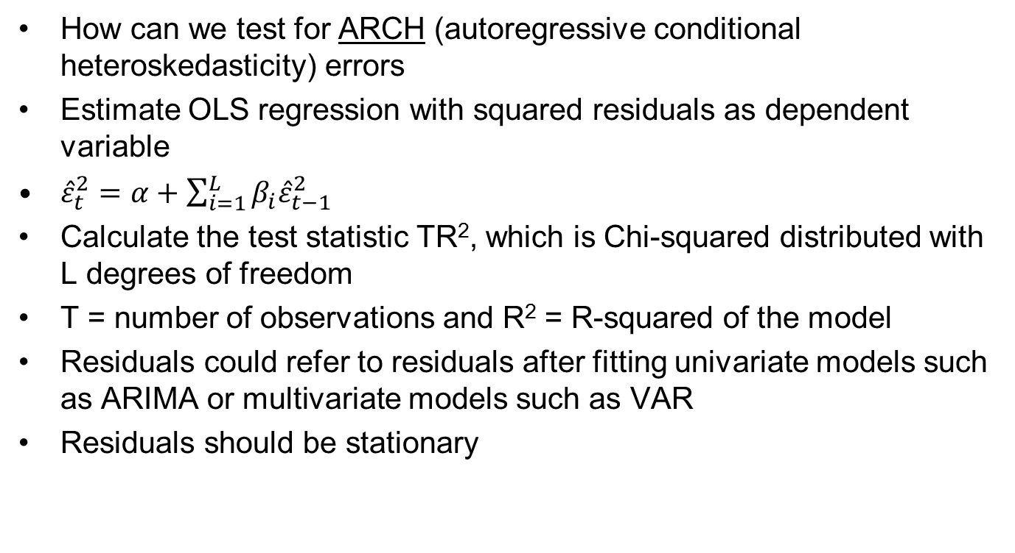
Testing for patterns
How can we test for ARCH (autoregressive conditional heteroskedasticity) errors
Estimate OLS regression with squared residuals as dependent variable
${\hat{ε}}_{t}^{2}=α+\sum_{i=1}^{L}{β_{i}{\hat{ε}}_{t−1}^{2}}$
Calculate the test statistic TR², which is Chi-squared distributed with L degrees of freedom
T = number of observations and R² = R-squared of the model
Residuals could refer to residuals after fitting univariate models such as ARIMA or multivariate models such as VAR
Residuals should be stationary
Professor Gerhard Kling
80

Slide 92
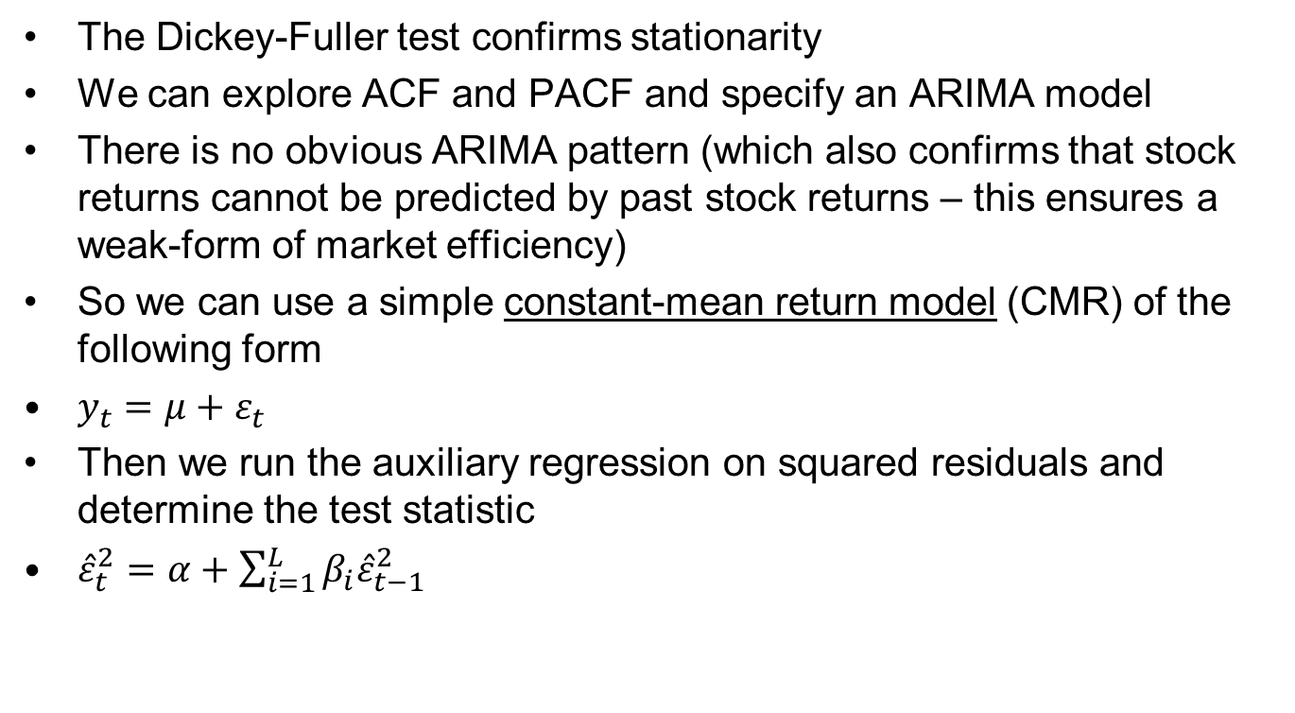
Testing stock returns for ARCH
The Dickey-Fuller test confirms stationarity
We can explore ACF and PACF and specify an ARIMA model
There is no obvious ARIMA pattern (which also confirms that stock returns cannot be predicted by past stock returns – this ensures a weak-form of market efficiency)
So we can use a simple constant-mean return model (CMR) of the following form
$y_{t}=μ+ε_{t}$
Then we run the auxiliary regression on squared residuals and determine the test statistic
${\hat{ε}}_{t}^{2}=α+\sum_{i=1}^{L}{β_{i}{\hat{ε}}_{t−1}^{2}}$
Professor Gerhard Kling
81

Slide 93
Lags in auxiliary regression
How many lags should we consider in the auxiliary regression?
One could explore the PACF of squared residuals
The PACF would suggest three lags
Hence, we consider squared residuals up to lag three
Professor Gerhard Kling
82

Slide 94
Auxiliary regression using OLS
Test statistic: TR² = 582*0.0264 = 15
Chi-squared with 3 (lags) degrees of freedom; p-value = 0.002
Additional lags should be considered
Using lag four produces an insignificant coefficient
Professor Gerhard Kling
83

Slide 95
ARCH test in STATA
The following procedure produces the ARCH test in STATA
*Three lags
reg r2 l.r2 l2.r2 l3.r2
scalar R=e(r2)
scalar N=e(N)
scalar T=R*N
gen p=1-chi2(3, T)
sum p
Professor Gerhard Kling
84

Slide 96
Estimating ARCH(3)
We estimate ARCH(3) based on our test procedure
If the number of lags exceed 3, I would suggest trying a GARCH(1,1) estimation
So start with ARCH(3) (in STATA: ‘arch’)
Check whether coefficients are significant
If coefficients are not significant, try to reduce the model (general-to-specific approach)
Try to estimate GARCH(1,1) as a benchmark
Compare models using AIC and BIC
Professor Gerhard Kling
85

Slide 97
ARCH(3) for stock returns
I estimate ARCH(3) and GARCH(1,1)
Based on AIC and BIC, GARCH(1,1) seems to be superior
NOTE: you need to check that the sum of the coefficients of GARCH(1,1) ≤ 1 (stability condition!)
Professor Gerhard Kling
86

Slide 98
Forecasting volatility
Once we found our ‘best’ model, we can forecast volatility
A similar approach should be used after ARIMA, VAR or VECM models
Professor Gerhard Kling
87

Slide 99
Workshop 3: Analysing the US housing market
Professor Gerhard Kling

Slide 100
To-do list (1/2)
Open the dataset ‘Workshop 2’
Define a time variable
Convert date into quarters (1 to 4) and years
Generate count variable time
‘tsset’ your data
Use a ‘twoway’ graph and two ‘line’ charts to plot house prices and GDP over time
Use two different y-axes to illustrate the relationship between house prices and GDP (HINT: use STATA help function for ‘twoway’ and explore the ‘line’ command)
Test whether house prices and GDP are cointegrated using the Engle-Granger method
Professor Gerhard Kling
88

Slide 101
To-do list (2/2)
Follow the steps of the Engle-Granger method
Determine the order of integration
Estimate the long-run equilibrium
Estimate the error-correction model
Try to forecast house prices
Forecast prices
Check out-of-sample forecast (maybe last year)
Is it a good time to invest in the US housing market?
Check whether residuals of the VECM exhibit an ARCH pattern
Professor Gerhard Kling
89

Slide 102
Unit 7: Structural breaks
Professor Gerhard Kling

Slide 103
What are structural breaks?
The relationship between variables changes over time
This might be caused by a policy change
It might be also due to parameter instability (e.g. time-varying beta)
Outliers can also cause breaks
How to deal with structural breaks?
Known structural breaks (e.g. policy change) can be modelled using an intervention analysis or by splitting the sample into different sub-periods
Unknown structural breaks (e.g. event, financial crisis) can be modelled ex-post
So after a break occurs, the break becomes obvious – but how to ‘forecast’ a break?
Professor Gerhard Kling
90

Slide 104
Chow test
The Chow test is only useful ex-post – so after observing that a break occurred
Split the sample period into a pre-break period and after-break period
Estimate a reference model for the whole period ignoring the alleged structural break
Run a second model using the whole period but consider an intercept dummy and interaction terms
Hence, we guess a break (e.g. financial crisis in 2008) and specify dummy variables
Intercept can change
Slope can change
Professor Gerhard Kling
91

Slide 105
US house prices and GDP
We can guess that the financial crisis in 2008 affected the relationship
We define a dummy variable for the post-break period
So all observations after the break are marked with a dummy that takes the value 1
Professor Gerhard Kling
92

Slide 106
Define dummy and interaction
We follow the procedure outlined below in STATA
*Define dummy variable
gen crisis=1 if time>=85
replace crisis=0 if crisis==.
*Interaction effect for slope coefficient
gen inter=crisis*price
*Run model for whole period
reg gdp price
*Run model with dummy and interaction
reg gdp price crisis inter
Professor Gerhard Kling
93

Slide 107
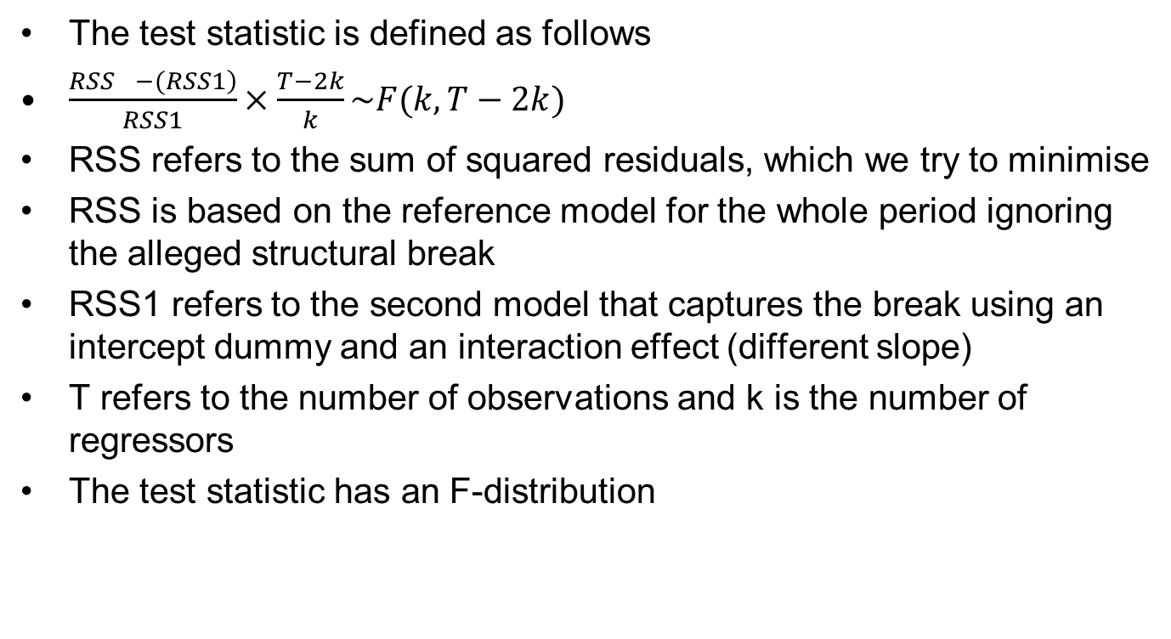
Constructing the test statistic
The test statistic is defined as follows
$\frac{\left.RSS_{}−(RSS1\right)}{RSS1}×\frac{T−2k}{k}\sim F(k,T−2k)$
RSS refers to the sum of squared residuals, which we try to minimise
RSS is based on the reference model for the whole period ignoring the alleged structural break
RSS1 refers to the second model that captures the break using an intercept dummy and an interaction effect (different slope)
T refers to the number of observations and k is the number of regressors
The test statistic has an F-distribution
Professor Gerhard Kling
94

Slide 108
Test statistic in STATA
We follow the procedure outlined below in STATA
reg gdp price
scalar RSS=e(rss)
reg gdp price crisis inter
scalar RSS1=e(rss)
scalar T=e(N)
scalar k=e(df_m)
scalar C=(RSS-RSS1)/RSS1*(T-2*k)/k
*P-value
gen p=Ftail(k,T-2*k,C)
sum p
Professor Gerhard Kling
95

Slide 109
Do we have a structural break?
The Chow test indicates a structural break at t=85 (refers to 2008)
The question is whether this is the only structural break
Looking at the figure, one could also consider additional ‘breaks’ whenever the two time series intercept
Breaks could also mark the up and downturns in the housing market
Additional Chow tests can confirm whether additional breaks improve the model fit
This time RRS1 would be the reference point for further improvement
As the R-squared is already 94%, additional breaks do not seem to be promising
Professor Gerhard Kling
96

Slide 110
And if we don’t know the break?
The Chow test is useful as an ex-post confirmation for structural breaks
If the timing of the structural break is unknown, we can use alternative approaches
The Quandt likelihood ratio test refers to an iterated process of Chow tests with different break points
Using a loop command, we generate all possible dummies and interaction effects and run Chow tests for every possible break point
F-statistics for different break tests can be plotted, and we can select break points with high values of the test statistic
QLR follows a non-standard distribution (see Stock and Watson, 2003, Table 12.5; Andrews,1993)
Professor Gerhard Kling
97

Slide 111
Quandt likelihood ratio test (1/3)
Please note the use of loop commands
*Quandt likelihood ratio test
scalar drop _all
drop crisis inter
*Benchmark model
reg gdp price
scalar RSS=e(rss)
*Assume first 10 and last 10 observations don't break
gen break=.
Professor Gerhard Kling
98

Slide 112
Quandt likelihood ratio test (2/3)
Please note the use of loop commands
forvalues i=10/92 {
gen crisis=1 if time>=`i'
replace crisis=0 if crisis==.
gen inter=crisis*price
qui: reg gdp price crisis inter
scalar RSS1=e(rss)
scalar T=e(N)
scalar k=e(df_m)
scalar C=(RSS-RSS1)/RSS1*(T-2*k)/k
matrix C=C
svmat C, n(C)
…
Professor Gerhard Kling
99

Slide 113
Quandt likelihood ratio test (3/3)
Please note the use of loop commands
...
egen max=max(C1)
replace break=max if time==`i' & break==.
drop C1 max crisis inter
scalar drop RSS1 T k
matrix drop C
}
Professor Gerhard Kling
100

Slide 114
Result of Quandt test
We plot the test statistics over time
The structural break occurred much earlier
The maximum F-test was reached in the first quarter of 2005
It would have been a good point to exit the market
Professor Gerhard Kling
101

Slide 115
Recursive methods
We start with a sub-period close to the minimum required for estimation, which refers to about 30 observations (for instance, t<31)
We sequentially add one observation at a time and re-estimate the model until the end of the period
Initial estimates of parameters should improve and stabilise by adding more information (additional observations)
The CUSUM and CUSUM squared refer to recursive residuals that result from the recursive method outlined above
Professor Gerhard Kling
102

Slide 116
CUSUM test
The CUSUM statistic should be zero, as recursive residuals should have a mean of zero; hence, the sum of residuals should be zero
In fact, recursive residuals should behave like a white-noise process
In STATA, the command ‘cusum6’ can be used, which needs to be installed
You can also construct your own recursive residuals using rolling regressions and the recursive method
Professor Gerhard Kling
103

Slide 117
The rolling command
The following approach can be used to determine recursive residuals
rolling, recursive window(20) clear: reg gdp price, r
drop start
rename end time
tsset time
save “Results.dta", replace
use “Interim.dta", clear
merge time using " Results.dta "
drop _merge
gen residual=gdp-(_b_cons+_b_price*price)
line residual time
Professor Gerhard Kling
104

Slide 118
CUSUM test using cusum6
We plot the CUSUM test
The CUSUM test is quite generous and does not detect structural breaks based on a 95% confidence interval
Hence, one should try different approaches
Professor Gerhard Kling
105

Slide 119
Unit 8: Panel VAR and cointegration
Professor Gerhard Kling

Slide 120
Panel data and time series
Quite often you have access to a particular time series (e.g. GDP, inflation)
However, you also observe the time series for different cross-sectional units (e.g. countries, firms, industries)
The resulting data structure looks like a panel dataset – but the time dimension can exceed the cross-sectional dimension (example: annual data from 1950 for 5 countries)
Thus, we need to use the methods developed in the section on multivariate time series modelling (e.g. VAR, cointegration)
These methods can be modified to capture the heterogeneity across units of observations (e.g. country-specific effects)
Professor Gerhard Kling
106

Slide 121
Structure of panel data
Why does the data structure matter?
Depending on dimensions, a dataset has to be reorganised so that STATA is able to understand its structure
Example: Panel data
Country | Year | GDP growth | Inflation | …
A | 2009 | 1.2% | 2.1%
A | 2010 | -0.2% | 0.6%
B | 2009 | 0.8% | 1.2%
B | 2010 | 0.2% | 0.9%
Professor Gerhard Kling
107

Slide 122
Ignoring the cross section
One approach is to ignore the fact that we have a cross section
This can be done by defining an artificial time dimension that simply counts observations
We only need to be careful if we move between different units of observations
Example: if we want to run an ARIMA model, we need to ensure that lagged variables refer to the same unit of observation
If we tsset our data and reveal the panel structure (e.g. tsset code year), STATA will refuse to execute ARIMA
Professor Gerhard Kling
108

Slide 123
Panel unit-root tests
There are several panel unit root tests (e.g. Hadri LM, Im test, Levin test, Multivariate Dickey Fuller)
These tests are available in STATA or can be installed using the STATA help function
Many studies that work with panel data do not test for unit-roots, which is problematic, as non-stationary time series can exist in panel data
For instance, many studies use firm size as an explanatory variable (to account for economies of scale)
Firm size is usually measured by the natural logarithm of total assets
It is unlikely that total assets are stationary; hence, panel models are spurious
Professor Gerhard Kling
109

Slide 124
Example: firm size
The STATA (STATA version 12) command ‘xtunitroot’ contains several panel unit-root tests
Alternatively, tests can be downloaded
Firm size does not look stationary even before applying further tests
Tests in STATA require a strongly balanced panel
Missing values can be a problem
Professor Gerhard Kling
110

Slide 125
Example: Breitung test
In STATA: xtunitroot breitung size
So firm size is non-stationary
Again we have the same options as before: first-differencing or cointegration
Professor Gerhard Kling
111

Slide 126
Panel VAR
Let’s first-difference firm size and explore the relation between firm size and profits (EBIT)
We ignore the panel dimension first and estimate a standard (reduced form) VAR, which is actually based on OLS (so it is similar to running a panel or system OLS)
We can run OLS with lagged variables and run two models (one with size and one with profit as dependent variable)
tsset code year
reg d.size l.d.size l.d.EBIT
estimates store A
reg d.EBIT l.d.size l.d.EBIT
estimates store B
estimates table A B, b(%9.3f) star
Professor Gerhard Kling
112

Slide 127
POLS results
The table shows POLS for size (A) and profit (B)
There does not seem to be a link between changes in size and profits
We also need to explore different lag specifications
Professor Gerhard Kling
113

Slide 128
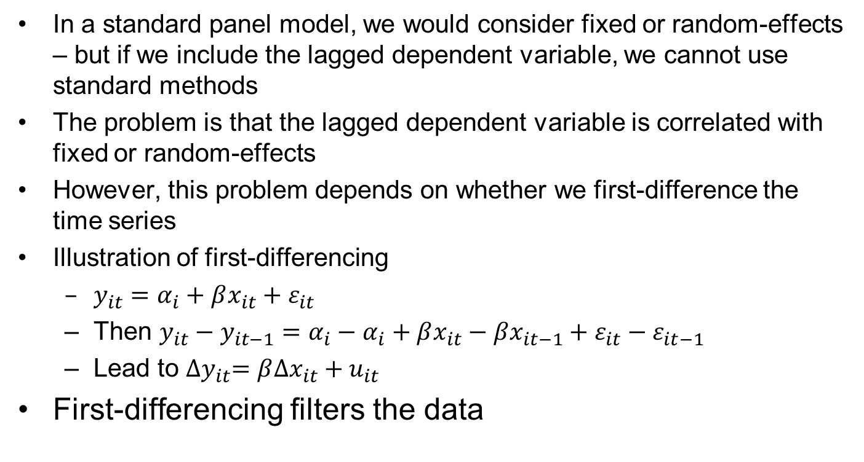
Firm-specific effects
In a standard panel model, we would consider fixed or random-effects – but if we include the lagged dependent variable, we cannot use standard methods
The problem is that the lagged dependent variable is correlated with fixed or random-effects
However, this problem depends on whether we first-difference the time series
Illustration of first-differencing
$y_{it}=α_{i}+βx_{it}+ε_{it}$
Then $y_{it}−y_{it−1}=α_{i}−α_{i}+βx_{it}−βx_{it−1}+ε_{it}−ε_{it−1}$
Lead to ${∆y}_{it}=β∆x_{it}+u_{it}$
First-differencing filters the data
Professor Gerhard Kling
114

Slide 129
Panel VAR in levels
If we do not apply first-differencing and run a panel VAR, we need to follow a different approach
We can use dynamic panel data estimators
In STATA: xtabond is available, which refers to the Arellano-Bond linear dynamic panel-data estimation
The Arellano-Bond method is widely used to analyse panel data models with lagged dependent variables
Example: let’s explore profitability defined as return on assets (ROA) over time
Professor Gerhard Kling
115

Slide 130
ROA is a stationary time series
The time series looks stationary
So we can try to model ROA in levels
Again we might be interested in the impact of firm growth on ROA
Professor Gerhard Kling
116

Slide 131
Arellano-Bond method
Using xtabond in STATA with one lag
Increase in firm size has a negative impact on ROA in the following year – but only at the 90% level of confidence
Professor Gerhard Kling
117

Slide 132
Panel cointegration
Testing for cointegration in panels is not straightforward
Maybe the simplest test procedure was developed by Larsson, Lyhagen, and Lothgren (2001) and is based on the Johansen test statistics for individual series. They proposed to calculate the average of the individual trace statistics
Pedroni (1999) proposed several test statistics
Estimating the long-run equilibrium
The standard dynamic ordinary least squares (DOLS) estimator can be used to obtain estimates for β_{I}
Inference should be based on Newey-West (1987) method
Professor Gerhard Kling
118

Slide 133
Workshop 4: Analysing cross-country data
Professor Gerhard Kling

Slide 134
To-do list (1/2)
Open the dataset ‘Workshop 4’
Define a time variable
Convert date into years
‘tsset’ your data
Plot the GDP of the UK and France over time using two different y-axes
Determine the order of integration of both time series
Can the two time series be cointegrated?
Estimate the long-run equilibrium
Explore the residuals over time, and test whether residuals are stationary
Professor Gerhard Kling
119

Slide 135
To-do list (2/2)
Are there any structural breaks?
Guess structural breaks and determine Chow tests
After testing for structural breaks, use the better model (with or without structural breaks) and explore the residuals
Are the residuals stationary?
Use the Quandt likelihood ratio test and look for additional structural breaks
What happens if you consider more than one structural break?
Professor Gerhard Kling
120

